Slide 1
Polymorphism

Slide 2

Polymorphism
In school behave like a student
In Bus behave like a passenger
In home behave like a son
In Shopping mall behave like a customer

Slide 3
Real-life examples of Polymorphism
Water is a liquid at normal temperature, but it can be changed to solid when it frozen, or same water changes to a gas when it is heated at its boiling point.
The person can be causal with his friends, professional with his colleagues and seniors.
The smartphone can act as phone, camera, music player and what not, taking different forms and hence polymorphism

Slide 4
Polymorphism
Polymorphism is taken from the Greek words Poly (many) and morphism (forms).
The literal meaning of polymorphism is the condition of occurrence in different forms.
It refers to the use of a single type entity (method, operator or object) to represent different types in different scenarios.

Slide 5
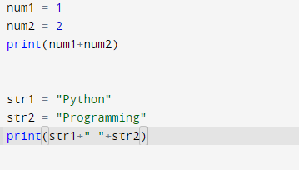
Polymorphism with ‘+’ operator

Slide 6
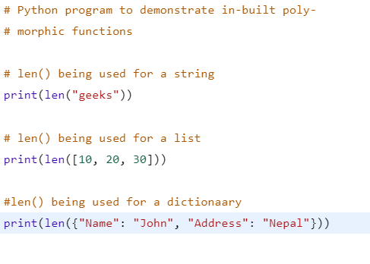
Inbuilt polymorphic functions

Slide 7
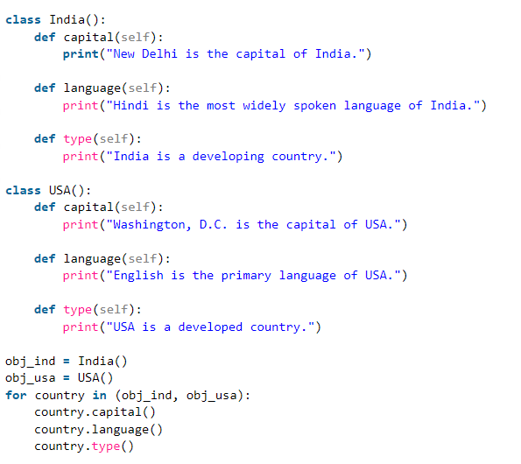
Polymorphism with class methods

Slide 8
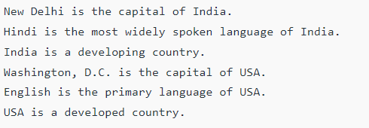
Output

Slide 9
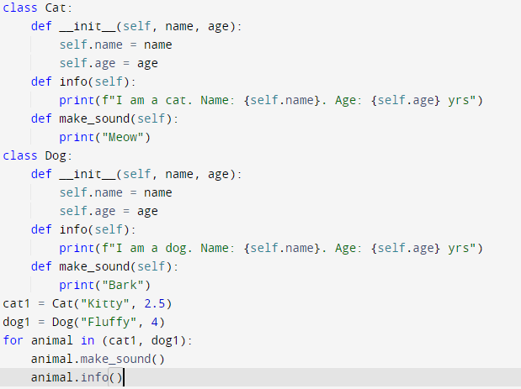
Polymorphism with class methods

Slide 10

Output

Slide 11
Polymorphism and Inheritance
In Python, Polymorphism lets us define methods in the child class that have the same name as the methods in the parent class. In inheritance, the child class inherits the methods from the parent class. However, it is possible to modify a method in a child class that it has inherited from the parent class. This is particularly useful in cases where the method inherited from the parent class doesn’t quite fit the child class. In such cases, we re-implement the method in the child class. This process of re-implementing a method in the child class is known as Method Overriding.

Slide 12
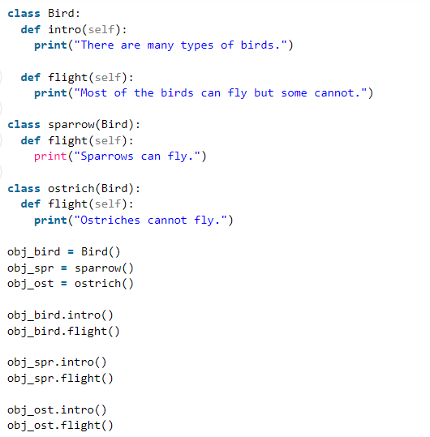
Polymorphism and Inheritance

Slide 13
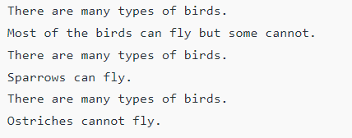
Output

Slide 14
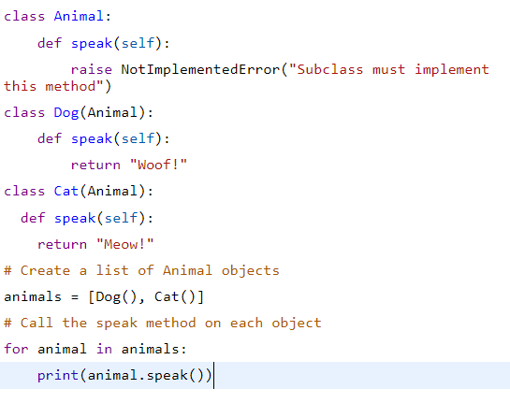
Polymorphism and Inheritance

Slide 15
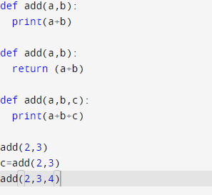
Python & other programming languages
Method Overloading, a way to create multiple methods with the same name but different arguments, is not possible in Python.

Slide 16
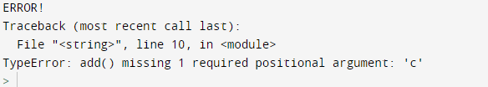
Python & other programming languages
Method Overloading, a way to create multiple methods with the same name but different arguments, is not possible in Python.

Slide 17
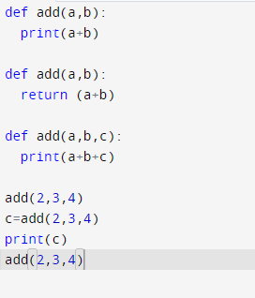

Python & other programming languages
Method Overloading, a way to create multiple methods with the same name but different arguments, is not possible in Python.

